Slide 1
DBA Database Design

Slide 2
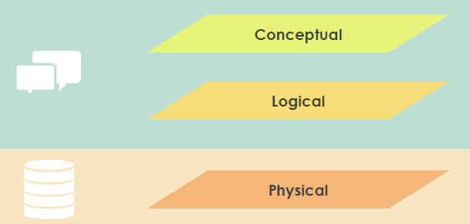
The Three-Levels of ER Model

Slide 3
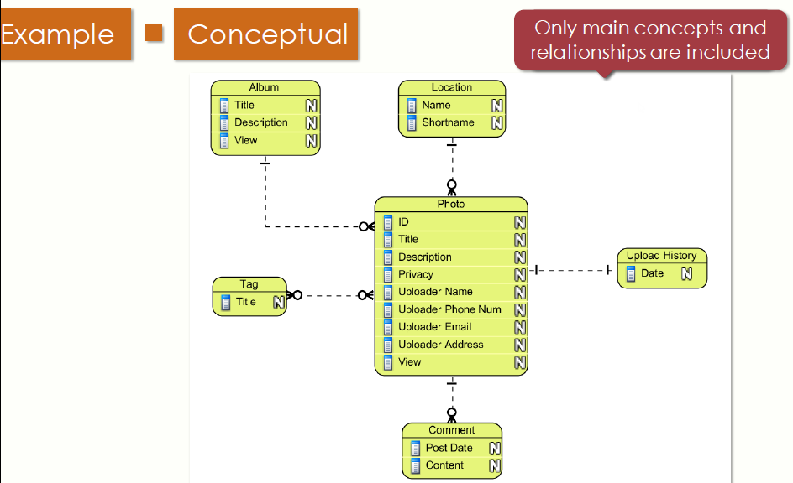
Conceptual

Slide 4
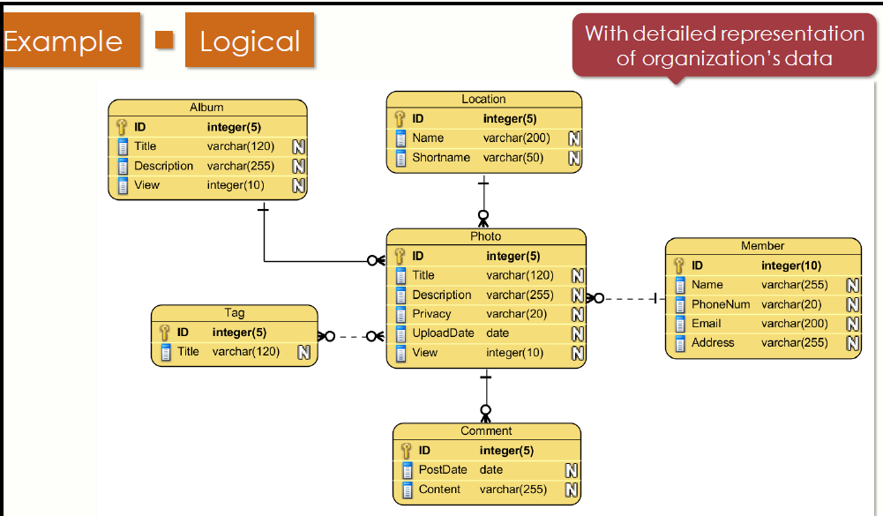
Logical

Slide 5
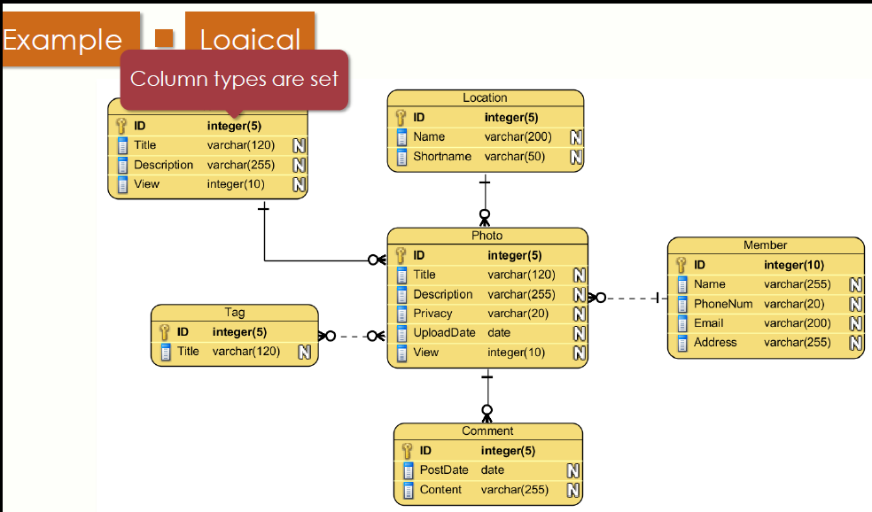
Logical

Slide 6
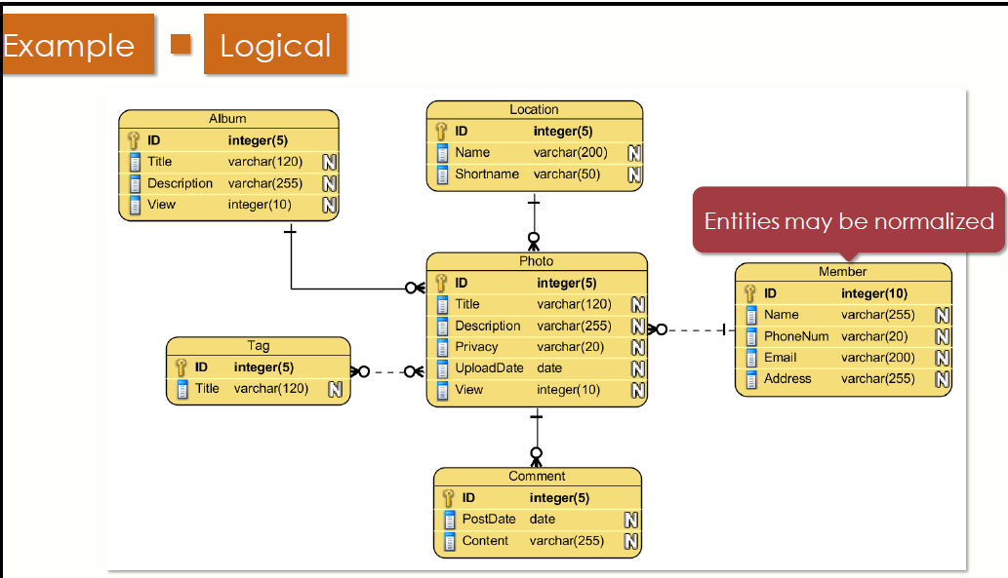
Logical

Slide 7
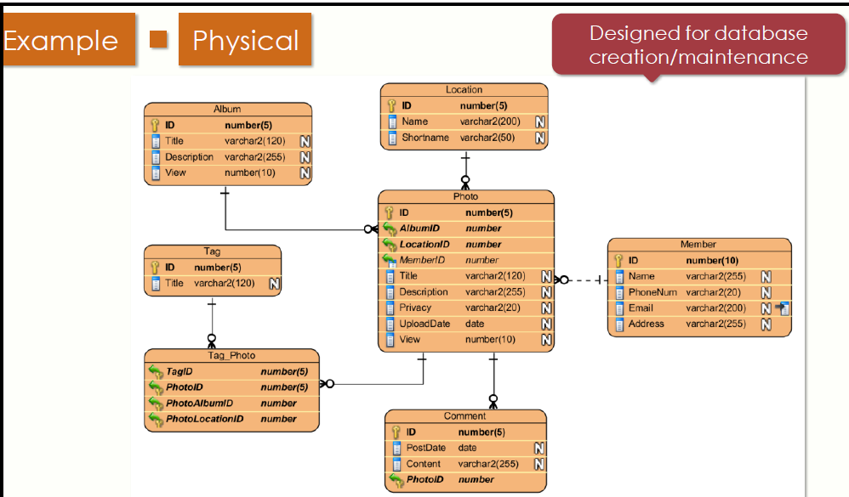
Physical

Slide 8
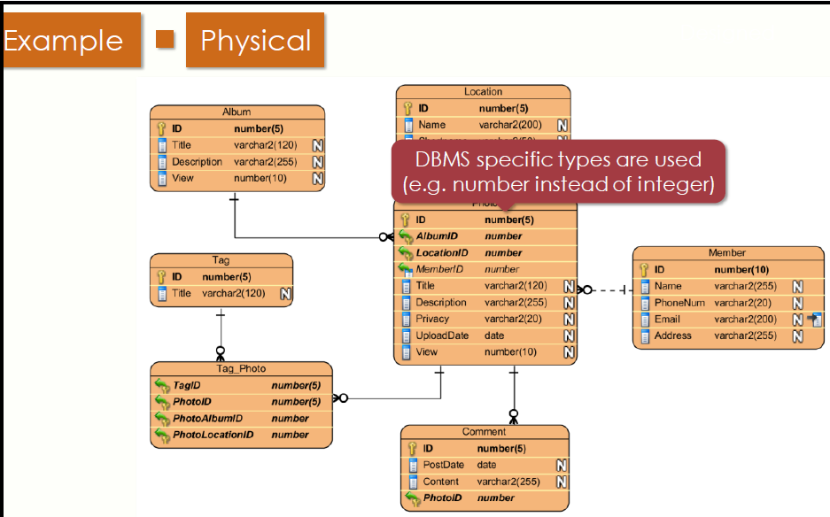
Physical

Slide 9
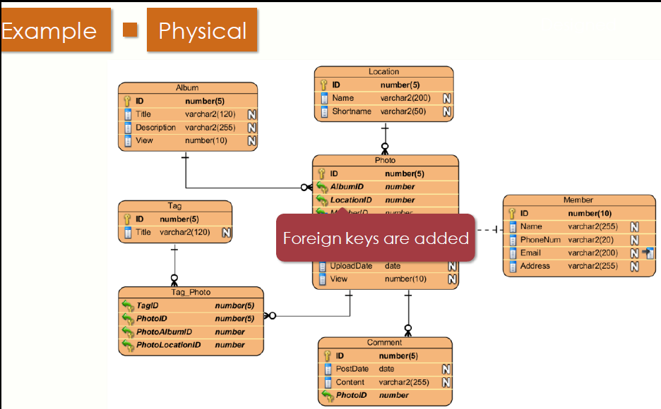
Physical

Slide 10
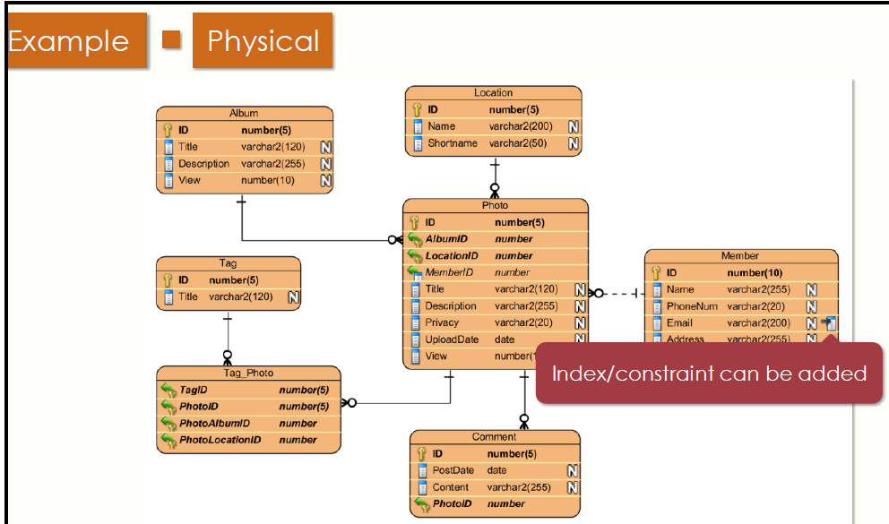
Physical

Slide 11
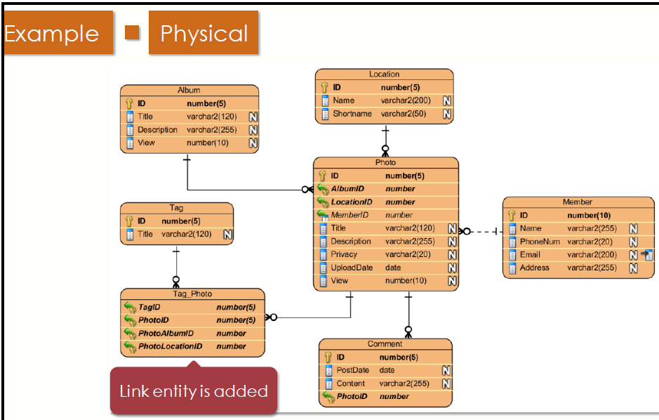
Physical

Slide 12
Referencias
Database System Concepts, 7th Ed.©Silberschatz, Korth and Sudarshan, 2019
https://www.udemy.com/database-design-and-management/learn/v4/content

